Slide 1
Learning Analytics and Knowledge 2011, Banff
Learning Analytics and Exploratory Dialogue
Rebecca Ferguson @R3beccaF
Simon Buckingham Shum @sbskmi
SocialLearn Project The Open University, UK
www.open.ac.uk/sociallearn
Notes:
This is work led by Rebecca Ferguson, one of my research fellows, who can’t be here unfortunately so this is on her behalf.
The Open University has been gathering learning analytics since the Institute of Educational Technology was set up in 1969, and in recent learning analytics talks, on my blog and slideshare, I’ve described how technology is enabling us to model trends and patterns computationally.
A challenge that we now recognise, and which has been a strong theme here at LAK, is analytics which can illuminate the quality of reasoning and discourse (not just the quantity — which is obviously easier to capture in computational form).
Anna has just described how we can use structured deliberation platforms, like Cohere, to make thinking more visible, and provide the machine with deeper access to the structure of reasoning and discourse.
In this talk we describe research in its early stages, investigating whether we can identify where language is being used to construct knowledge.

Slide 2
Context of this research
www.open.ac.uk/sociallearn
Learning space tuned for enquiry and sensemaking:
Social networking
Google gadgets
Mentoring
Open educational resource pathways
Analytics
Recommendation engine

Slide 3
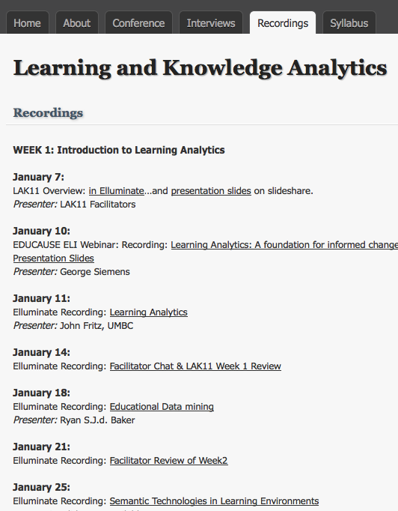
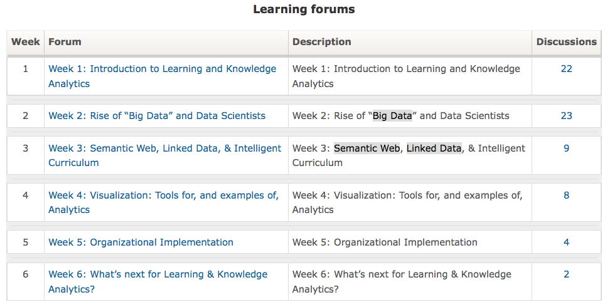
Hours of material…can LA help spot the critical, knowledge-building discourse?...

Slide 4
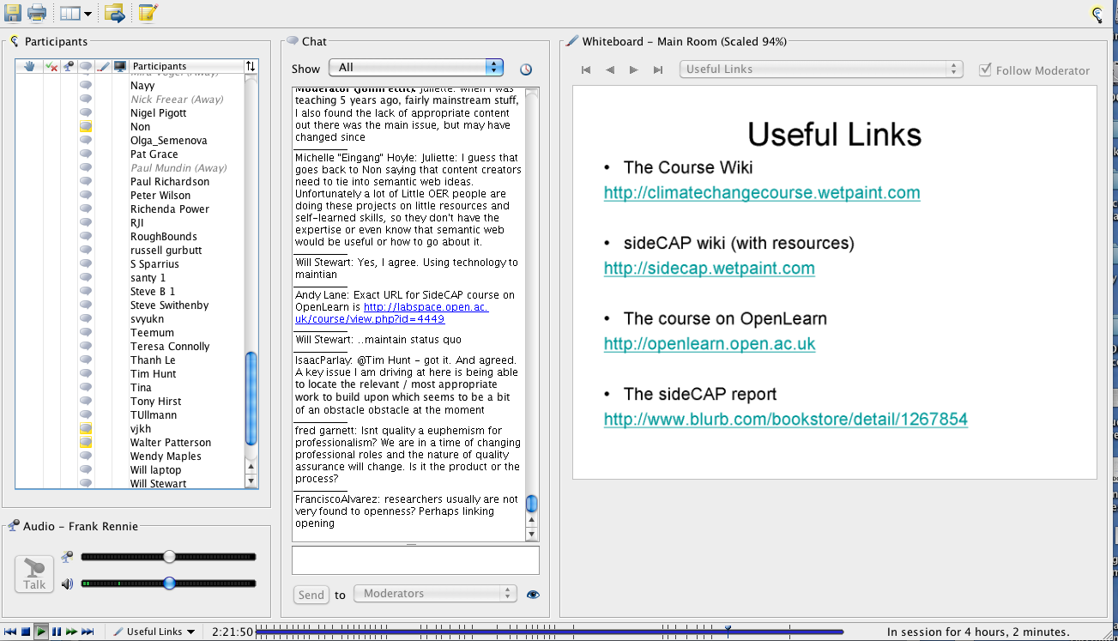
How many points in the webinar triggered learning/knowledge-building?
Data in this study taken from a 2 day OU conference in Elluminate & Cloudworks: http://cloudworks.ac.uk/cloudscape/view/2012
Notes:
Most people in the room will be familiar with Elluminate, probably from the LAaK course that was run over the last few weeks.
Those people who got behind with their participation in the course will have looked for quick ways to catch up. But with hours and hours of Elluminate sessions, how do you quickly find your way to the key points?
This isn’t only a problem for people on massively online courses. 26% of OU courses now use Elluminate. Last autumn, Elluminate was for the first time used on all OU languages modules for the compulsory speaking-test element of the EMA,
This research is investigating whether we can analyse the text chat window, ringed in red here, to identify the key periods during which participants are building knowledge together.
Data in this study taken from a 2 day OU conference in Elluminate & Cloudworks: http://cloudworks.ac.uk/cloudscape/view/2012

Slide 5
Data source: OU online conference
Data in this study taken from a 2 day OU conference in Elluminate & Cloudworks: http://cloudworks.ac.uk/cloudscape/view/2012

Slide 6
Disputational/Cumulative/Exploratory talk
Disputational talk
characterised by disagreement and individualised decision making. Few attempts to pool resources, to offer constructive criticism or make suggestions. Disputational talk also has some characteristic discourse features - short exchanges consisting of assertions and challenges or counter assertions ('Yes, it is.' 'No it's not!').
Cumulative talk
in which speakers build positively but uncritically on what the others have said. Partners use talk to construct a 'common knowledge' by accumulation. Cumulative discourse is characterised by repetitions, confirmations and elaborations.
Mercer, N. (2004). Sociocultural discourse analysis: analysing classroom talk as a social mode of thinking. Journal of Applied Linguistics, 1(2), 137-168.
Notes:
This draws on a large body of work by Neil Mercer and his colleagues. They examined spoken talk in face-to-face classrooms, and identified three types of talk that take place when learners are attempting to construct knowledge together. Cumulative talk is useful, but the form of talk that is most characteristic of an educated discourse is exploratory talk. People use this when they are building knowledge together.
Rebecca’s thesis showed that these three forms of dialogue are also important in online environments and that they appear in typed online talk, for example in asynchronous forums.

Slide 7
Disputational/Cumulative/Exploratory talk
Exploratory talk
Partners engage critically but constructively with each other's ideas.
Statements and suggestions are offered for joint consideration.
These may be challenged and counter-challenged, but challenges are justified and alternative hypotheses are offered.
Partners all actively participate and opinions are sought and considered before decisions are jointly made.
Compared with the other two types, in Exploratory talk knowledge is made more publicly accountable and reasoning is more visible in the talk.
Mercer, N. (2004). Sociocultural discourse analysis: analysing classroom talk as a social mode of thinking. Journal of Applied Linguistics, 1(2), 137-168.
Notes:
This draws on a large body of work by Neil Mercer and his colleagues. They examined spoken talk in face-to-face classrooms, and identified three types of talk that take place when learners are attempting to construct knowledge together. Cumulative talk is useful, but the form of talk that is most characteristic of an educated discourse is exploratory talk. People use this when they are building knowledge together.
Rebecca’s thesis showed that these three forms of dialogue are also important in online environments and that they appear in typed online talk, for example in asynchronous forums.

Slide 8
Example from Mercer (classroom discussion)
George I think she should be saying 'Did you steal my money from me?’
Tina Your go.
Sophie I think we should put 'I thought that my money's gone missing and I thought it was
you'.
George 'I think it was you'.
Sophie Which one?
Tina Now what was it I was going to say, Um, um
George No because she's thinking, so we need to do a thought. So we could write her saying
Sophie 'My money's gone missing so’
Tina I was going to say if we're doing the one where she's saying, this is saying not thinking
Sophie 'My money's gone do you know where it is?'
Tina No, on the saying one she could say
George You should be saying
Tina Like she could be thinking to say to Robert, she could be saying 'Do you know where's
my money?’ ‘Do you know anything about my money going missing?’
George Yeah, what, yeah that's good. When she's thinking i think she should be thinking 'Oh
my money's gone missing and its definitely Robert.
Tina Yeah
Sophie No 'cos she's saying it to him isn't she?
Tina No she's thinking at the moment.
Explicit reasoning
Challenge
Evaluation
Notes:
This is a slightly reduced data example from
Mercer, N. (2004). Sociocultural discourse analysis: analysing classroom talk as a social mode of thinking. Journal of Applied Linguistics, 1(2), 137-168.
It demonstrates the use of exploratory talk in a face-to-face classroom. The blue words identify some of the characteristics of exploratory talk that are being demonstrated here. The text in red identifies some of the key phrases that indicate these characteristics are present in the talk.
(The text is a version of the sample that appears in Neil’s book – it is slightly reduced in order to fit it clearly on a PowerPoint slide. The used of red and blue text is mine – Neil was not trying to single out key phrases in this way, he was considering the passage as a whole.)

Slide 9
Indicators of exploratory talk?
Category | Indicator
Challenge | But if, have to respond, my view
Critique | However, I’m not sure, maybe
Discussion of resources | Have you read, more links
Evaluation | Good example, good point
Explanation | Means that, our goals
Explicit reasoning | Next step, relates to, that’s why
Justification | I mean, we learned, we observed
Reflections of perspectives of others | Agree, here is another, makes the point, take your point, your view
Notes:
Neil Mercer and his colleagues applied sociocultural discourse analysis to classroom talk in order to identify passages of exploratory talk. This involved a detailed reading and re-reading of the transcribed text by human analysts. This research seeks to automate this process, by identifying the key features of exploratory dialogue, and then associating these with words or phrases.
Examples are in the table on this slide. The categories on the left are features of exploratory dialogue. So, if someone says ‘good example’ or ‘good point’, this suggests that they may be engaging in evaluation, or encouraging others to engage in evaluation. This holds true even if they are actually saying ‘I’ve never heard anything less like a good example’ or ‘I doubt that’s the case. Can you give me a good example?’
Ninety-four key words and phrases that could be used as indicators were identified within our data (a two-day conference). Some promising ones were found to be misleading. We were looking for indications that people were engaging in dialogue about conference content, and so we chose not to use some markers than initially appeared promising, for example interrogatives and question marks because they were often related to phrases such as ‘Can everyone hear?’ or ‘What are we all doing for coffee???’

Slide 10
Low exploratory dialogue
(and text chat is often not well formed, making it hard to analyse with CompLing tools)
Time | Contribution
3:12 PM | LOL
3:12 PM | It's not looking good.
3:13 PM | Sorry, had to do that.
3:13 PM | jaaa
3:13 PM | Ouch!
3:13 PM | It was a vuvuzela.
3:13 PM | I though that was you @Alistair
3:13 PM | I've taken away the vuvuzela from you now!
3:13 PM
3:13 PM | LOL
3:13 PM | still 0-0?
Notes:
Once we had the markers, we ran an AppleScript on the conference chat text, which highlighted where they appeared. (The chat text consisted of 24,530 words in total – and we know that 233 people were logged in at some point during the two-day programme.)
So, here is one minute of Elluminate text chat
(the conference took place during football’s World Cup, which is why there are references to vuvuzelas).
The analysis suggested that there was no exploratory dialogue related to the content of the conference going on here.
You’ll see by looking at this, one of the reasons why it would be difficult to run a more sophisticated semantic analysis on this type of dialogue. People do not adhere to the conventions of formal written speech, they use sound effects, words that you would not find in a dictionary, emoticons, one sentence does not follow another, people do not use full sentences.

Slide 11
Higher exploratory dialogue
Time | Contribution
2:42 PM | I hate talking. :-P My question was whether "gadgets" were just basically widgets and we could embed them in various web sites, like Netvibes, Google Desktop, etc.
2:42 PM | Thanks, that's great! I am sure I understood everything, but looks inspiring!
2:43 PM | Yes why OU tools not generic tools?
2:43 PM | Issues of interoperability
2:43 PM | The "new" SocialLearn site looks a lot like a corkboard where you can add various widgets, similar to those existing web start pages.
2:43 PM | What if we end up with as many apps/gadgets as we have social networks and then we need a recommender for the apps!
2:43 PM | My question was on the definition of the crowd in the wisdom of crowds we acsess in the service model?
2:43 PM | there are various different flavours of widget e.g. Google gadgets, W3C widgets etc. SocialLearn has gone for Google gadgets
Notes:
Here is another minute of the conference
The analysis has flagged up that people are likely to be engaging in exploratory dialogue here, because four out of eight contributions contain markers.
This minute contains many of the characteristics of exploratory dialogue
challenge – why OU tools, not generic tools?
Critique – what if we end up with… My question was on the def of the crowd…

Slide 12
Discriminating between participants (1 hr)
 | Posts Mean = 5.4 | Word Mean = 47.3 | Ex posts Mean = 0.9 | Ex words Mean = 11.4 | Ex as % of all posts Overall 17% | Ex as % of all words Overall 24%
Alice | 5 | 13 | 0 | 0 | 0% | 0%
Ben | 5 | 36 | 1 | 2 | 20% | 6%
Chantelle | 5 | 59 | 2 | 38 | 40% | 64%
Dennis | 7 | 71 | 0 | 0 | 0% | 0%
Eric | 7 | 55 | 1 | 8 | 14% | 15%
Francesca | 9 | 117 | 1 | 26 | 11% | 22%
Gill | 12 | 91 | 2 | 9 | 17% | 10%
Harold | 13 | 86 | 2 | 30 | 15% | 35%
Moderator | 42 | 337 | 7 | 84 | 17% | 25%
Notes:
It’s all very well pulling out these clear-cut examples, but what was happening more broadly in the data?
This is a chart reflecting data from one 60-minute session. It represents the contributions of nine participants (who all have pseudonyms here) and shows differences between their dialogue in the chat.
The blue indicates figures above the mean for that hour
Alice was selected as someone who did not contribute any exploratory dialogue during the 60 minutes, according to the analysis. She posted five times, which was close to the mean number of postings for participants in that session, but she only used 13 words in those five postings, which puts her below average. None of her posts contained markers of exploratory talk
At the other end of the spectrum, the moderator posted 42 times during that hour, and these were not just one-word contributions, they included 337 words in all. Seven of these posts contained exploratory markers. Because the post was the unit of analysis, each word in an exploratory post is counted as an exploratory word. So the moderator was average, in that 17% of her posts included exploratory markers, but above average in that a quarter of her words were in those exploratory posts.
So the analysis points to differences between participants, and picks out some who seem likely to be actively engaged in knowledge building.

Slide 13
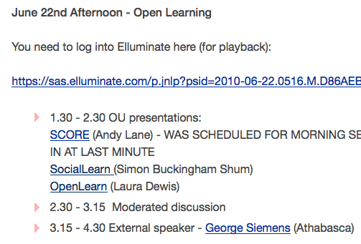
Discriminating between sessions
Source data: webinar: http://cloudworks.ac.uk/cloud/view/2994

Slide 14
Discriminating between sessions
 | APM | AWM | AXPM | AXWM | APE | AWE | AXPE | AXWE
OU Talks (60 mins) | 2.4 | 21.3 | 0.4 | 5.2 | 5.4 | 47.3 | 0.9 | 11.4
Discussion (45 mins) | 4.6 | 47.8 | 1.2 | 18.6 | 5.6 | 58.2 | 1.5 | 22.6
Keynote (75 mins) | 5.8 | 67.5 | 1.6 | 31.1 | 10.1 | 117.7 | 2.8 | 54.2
Chat (8 mins) | 8.8 | 57.6 | 0.9 | 11.8 | 3.3 | 22.0 | 0.3 | 4.5
Key: Average Xploratory Words Minute Posts Each
Source data: webinar: http://cloudworks.ac.uk/cloud/view/2994
Notes:
The analysis also discriminates between conference sessions. Here is one afternoon of the conference, which contained a number of talks about work at The Open University, related discussion, a Keynote, and a few minutes of chat before the Elluminate session ended. The left-hand side of the chart focuses on an analysis by time, and the right-hand side focuses on a per-person analysis. By all these measures, the Keynote appears to have provoked the most dialogue – and the most exploratory dialogue.
The keynote prompted 5.8 posts per minute, with 67.5 words per minute (By contrast, in the chat session, a lot more posts were appearing, but they were much shorter). From an exploratory point of view, there were 1.6 posts every minute that contained markers of exploratory dialogue, and 31.1 words appeared every minute in posts containing markers of exploratory dialogue.
The figures were also high on a per-person basis. Each participant in the Keynote contributed 10.1 posts on average – 117 words. Each person contributed on average 2.8 posts including exploratory markers, and these contained on average 54.2 words.
So the analysis suggests that if you were to listen to the archived conference, the keynote talk is the section to focus on, because this was the period during which participants were most engaged in knowledge construction.

Slide 15
Summary
More nuanced than generic analytics
More nuanced than conference timetable
Importance of context
Different types of learning
Notes:
In conclusion, we have found so far that these analytics are more nuanced than generic analytics – such as number of participants or number of postings. For example, the number of postings peaks at the end of chat sessions when everyone is saying thanks and goodbye, but there is not much learning going on at those points.
They are also more nuanced than using a published timetable, because this may have been amended, sessions overrun, and chat continues even after the formal session has finished.
Context was important – where a number of speakers were followed by a discussion session, there was relatively few markers of exploratory dialogue during the talks, but the discussion period was full of them. Unscheduled chat at the beginning of sessions tended to be primarily social, whereas unscheduled chat at the end contained more markers of exploratory dialogue.
In any online session there are likely to be three types of learning going on – people are learning about the course content, they are learning about the tools that give them access to that content, and they are learning about the people involved in the course. If you are involved in a session, you may engage in exploratory dialogue about all three of these. However, a refined version of this analysis needs to be able to distinguish exploratory dialogue relating to the technology and social issues from dialogue about the course content, as it is knowledge about the course content that is more likely to be of interest to anyone accessing an archived Elluminate session.

Slide 16
Future research needed in order to…
Check reliability of this form of analysis
Check validity of this form of analysis
Differentiate exploratory talk about content, tools, process, people
Investigate relationship between chat and audio/video
Automate process of analysis
Add more sophisticated text analysis
Notes:
This is initial research, and more remains to be done.
Four key areas for investigation are identified in this slide.

Slide 17
More sophisticated discourse analysis on longer texts
OLnet Project: KMi seminar replay: http://olnet.org/node/512

Slide 18
Future research needed in order to…
Check reliability of this form of analysis
Check validity of this form of analysis
Differentiate exploratory talk about content, tools, process, people
Investigate relationship between chat and audio/video
Automate process of analysis
Add more sophisticated text analysis
Notes:
This is initial research, and more remains to be done.
Four key areas for investigation are identified in this slide.

Slide 19
Rebecca Ferguson
The Open University, UK
http://oro.open.ac.uk/view/person/rf2656.html
http://www.slideshare.net/R3beccaF
Simon Buckingham Shum
The Open University, UK
http://oro.open.ac.uk/view/person/sjb72.html
http://www.slideshare.net/sbs
Notes:
Who we are.

