Slide 1
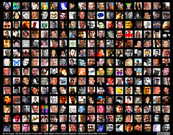
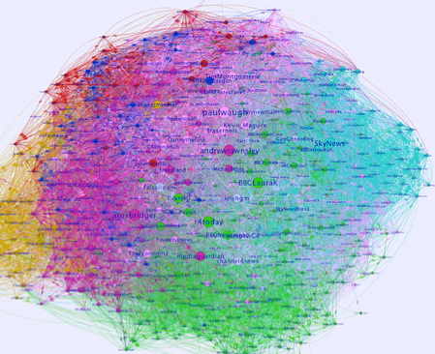
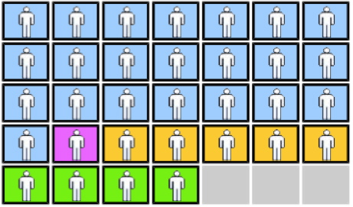
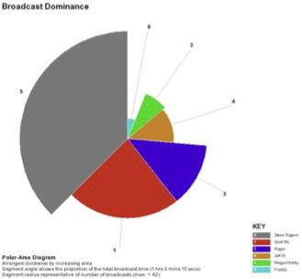
Keynote Address, Ascilite 2011, 6 Dec., Hobart, Tasmania
www.leishman-associates.com.au/ascilite2011
Learning Analytics Dream, Nightmare or Fairydust?
Simon Buckingham Shum
Knowledge Media Institute, The Open University UK
simon.buckinghamshum.net @sbskmi

Slide 2
Introducing a new Analytics Platform…

Slide 3
From a recent review…
“Some have tried to argue that this technology doesn't work out cost effectively when compared to conventional tests... but this misses a huge point. More often than not, we test after the event and discover the problem — but this is too late..”

Slide 4
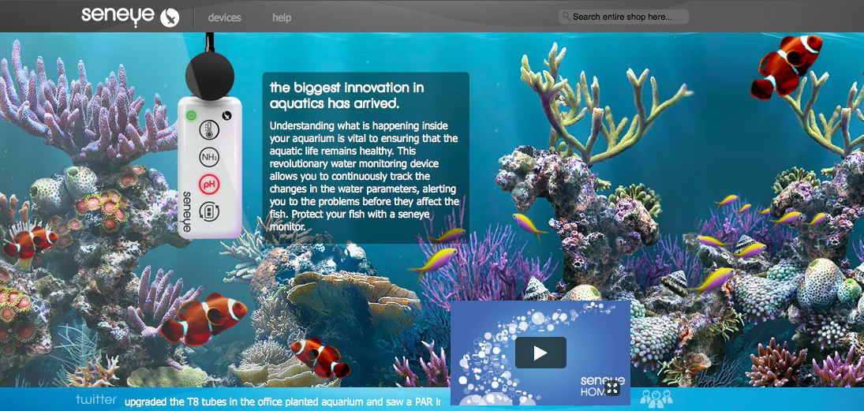
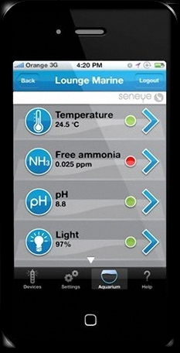
Aquarium Analytics!

Slide 5
Aquarium Analytics!

Slide 6
How is your aquatic ecosystem?
“This means that the keeper can be notified before water conditions directly harm the fish—an assured outcome of predictive software that lets you know if it looks like the pH is due to drop, or the temperature is on its way up.
This way, it’s a real fish saver, as opposed to a forensic examiner, post-wipeout.”
(From a review of Seneye, in a hobbyist magazine)

Slide 7
How is your learning ecosystem?
This means that the teacher can be notified before learning conditions directly harm the students — an assured outcome of predictive software that lets you know if it looks like engagement is due to drop, or attainment is on its way up.
This way, it’s a real student saver, as opposed to a forensic examiner, post-wipeout.

Slide 8
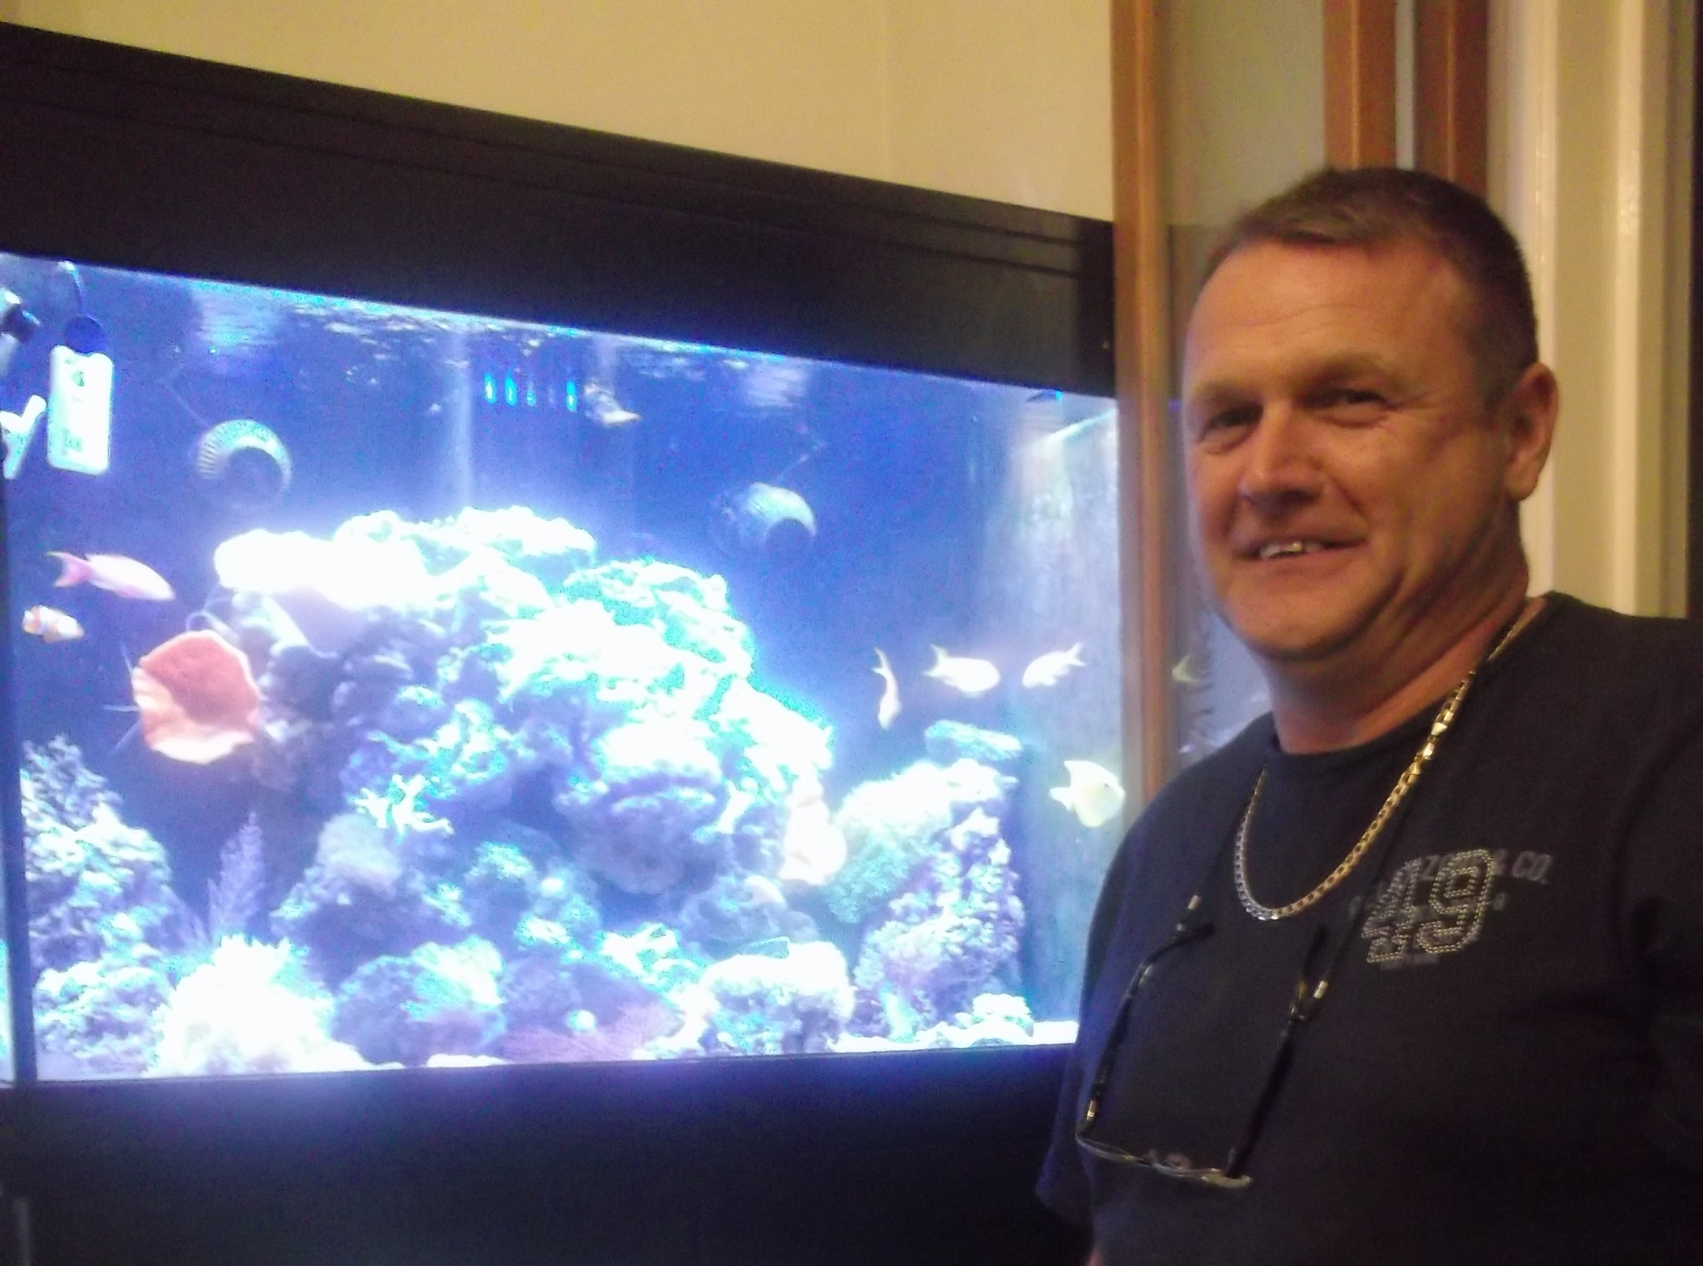
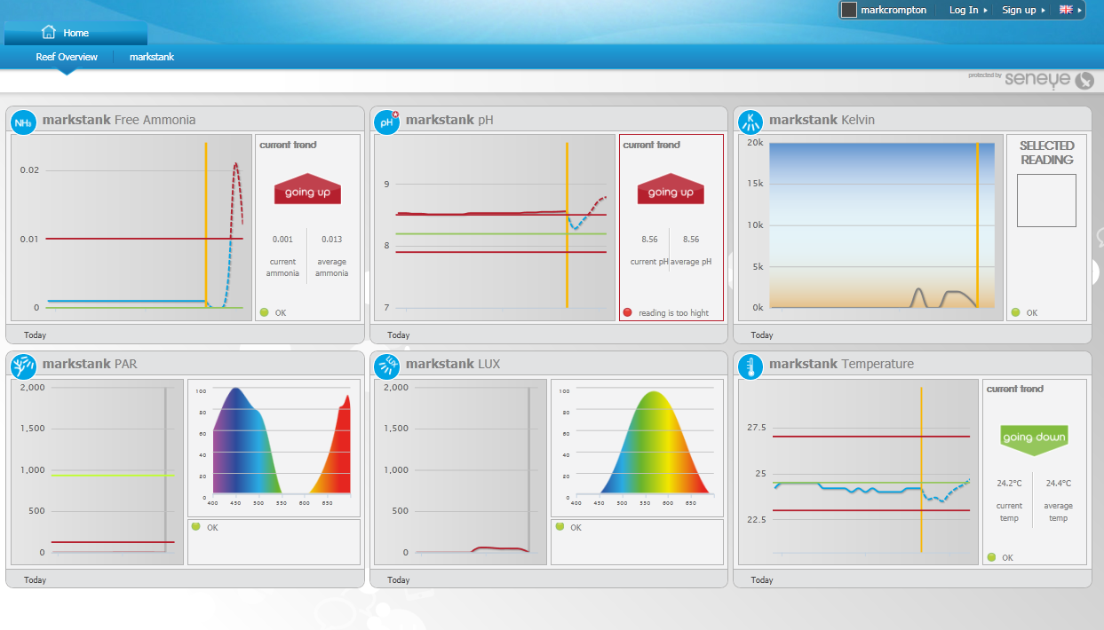
First-to-market immaturity, tricky install process…
…but when it’s done calibrating and the dashboard springs to life, there’s an exciting sense of control – BUT you still need to know what ‘good’ looks like

Slide 9
What do we mean by Learning Analytics?

Slide 10
Learning analytics
“Learning Analytics is concerned with the collection, analysis and reporting of data about learning in a range of contexts, including informal learning, academic institutions, and the workplace.
It informs and provides input for action to support and enhance learning experiences, and the success of learners.”
2nd Int. Conf. Learning Analytics & Knowledge 2012

Slide 11
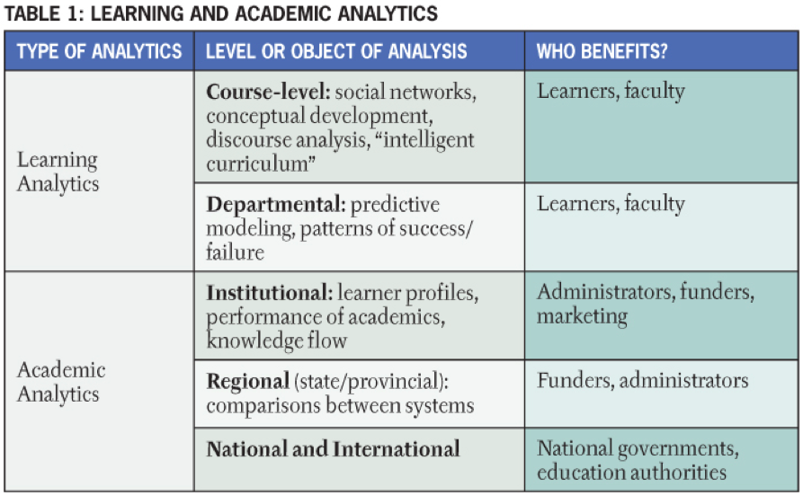
Learning “vs” Academic Analytics
Penetrating the Fog: Analytics in Learning and Education – George Siemens and Phil Long
http://www.educause.edu/EDUCAUSE+Review/EDUCAUSEReviewMagazineVolume46/PenetratingtheFogAnalyticsinLe/235017

Slide 12
“Academic Analytics”
Stage 1—Extraction and reporting of transaction-level data
Stage 2—Analysis and monitoring of operational performance
Stage 3—What-if decision support (such as scenario building)
Stage 4—Predictive modeling and simulation
Stage 5—Automatic triggers of business processes (such as alerts)
Goldstein, P. J. (2005). Academic Analytics: The Uses of Management Information and Technology in Higher Education: Key Findings. Boulder, Colorado: Educause Center for Applied Research http://net.educause.edu/ir/library/pdf/EKF/EKF0508.pdf
Notes:
Academic Analytics appears to be a term first proposed in a review of the maturity of business intelligence practices in educational institutions (Goldstein & Katz, 2005).

Slide 13
What this talk is not…
The future is analytics!
Step this way…

Slide 14
The future is analytics!
Step this way…

Slide 15
Power
Principles
Pedagogy

Slide 16
Power
Learning Analytics
Principles
Pedagogy

Slide 17
dream

Slide 18
dream
Nightmare

Slide 19
dream
Nightmare
Fairydust

Slide 20
Big Data & Analytics:
Very Big Buzzwords

Slide 21
SAS and Education
http://www.sas.com/industry/education/highered

Slide 22
IBM TechTrends2011 report: Analytics fastest growing tech

Slide 23
IBM TechTrends2011 report: Analytics fastest growing tech
…but do they know anything about the roles of language in learning?

Slide 24
Personal, volunteered Big Data is about to explode

Slide 25
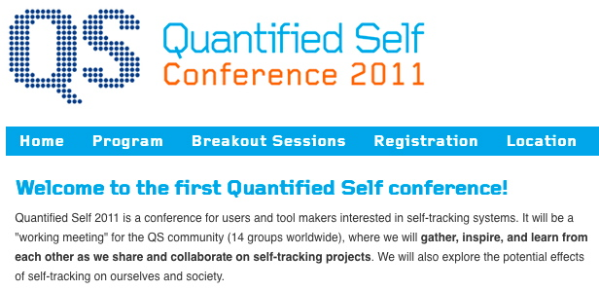
Explosion of data sharing about ourselves: personal health

Slide 26
Explosion of data sharing about ourselves: location

Slide 27
Big Data & Analytics:
Very Big Buzzwords
Educational Institutions
Educational Institutions

Slide 28
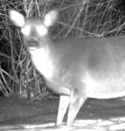
Your Educational Institution’s Response?
http://mcseavey.org/blog/2007/12/11/deer-in-headlights

Slide 29
Your Learners’ Response?
http://mcseavey.org/blog/2007/12/11/deer-in-headlights

Slide 30
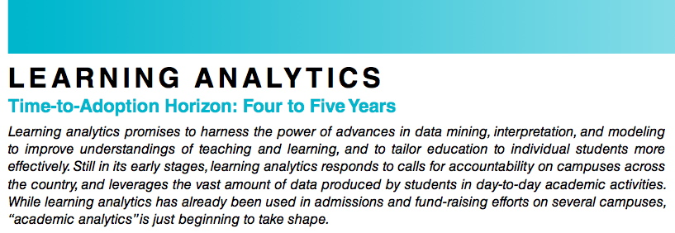
NMC Horizon 2011 Report: Learning Analytics (4-5yrs adoption)
L. Johnson, R. Smith, H. Willis, A. Levine, and K. Haywood, The 2011 Horizon Report (Austin, TX: The New Media Consortium, 2011), http://www.nmc.org/pdf/2011-Horizon-Report.pdf

Slide 31
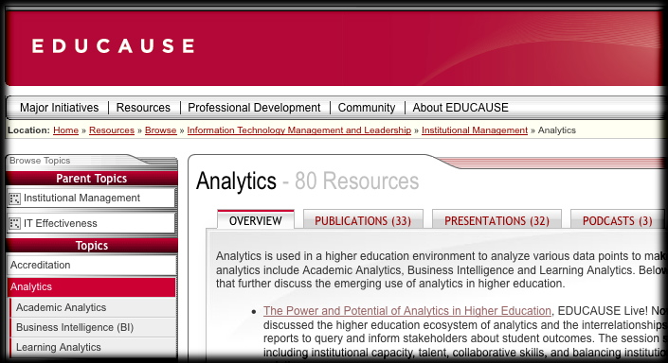
EDUCAUSE
http://www.educause.edu/Resources/Browse/Analytics/16961

Slide 32
Right here
Right now

Slide 33
Analytics in English schools RAISEonline cohort visualization

Slide 34
Analytics in your VLE: joules: analytics for Moodle
http://manuals.moodlerooms.com/display/JOULE2/joule+Reports+Manual

Slide 35
Analytics in your VLE: OU VLE Reporting & Tracking tools
Summary stats on number of views, edits and posts to: Forum, Wiki, Blog, Structured Content, Quiz, External Quiz, Google Docs, Elluminate sessions…

Slide 36
Analytics in your VLE: Blackboard: feedback to students
http://www.blackboard.com/Platforms/Analytics/Overview.aspx

Slide 37
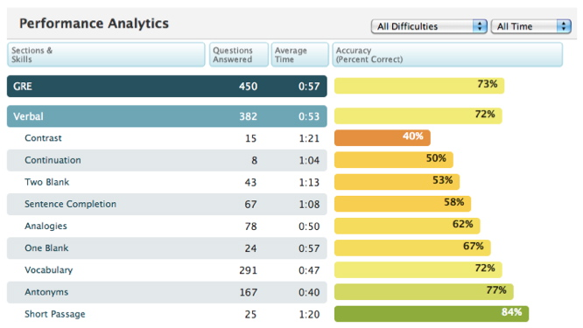
Analytics in your VLE: Grockit: feedback to students prepping for standardized tests
https://grockit.com/research

Slide 38
Analytics in your VLE: Desire2Learn visual analytics
http://www.desire2learn.com/demos/Analytics/
Students
Online tools

Slide 39
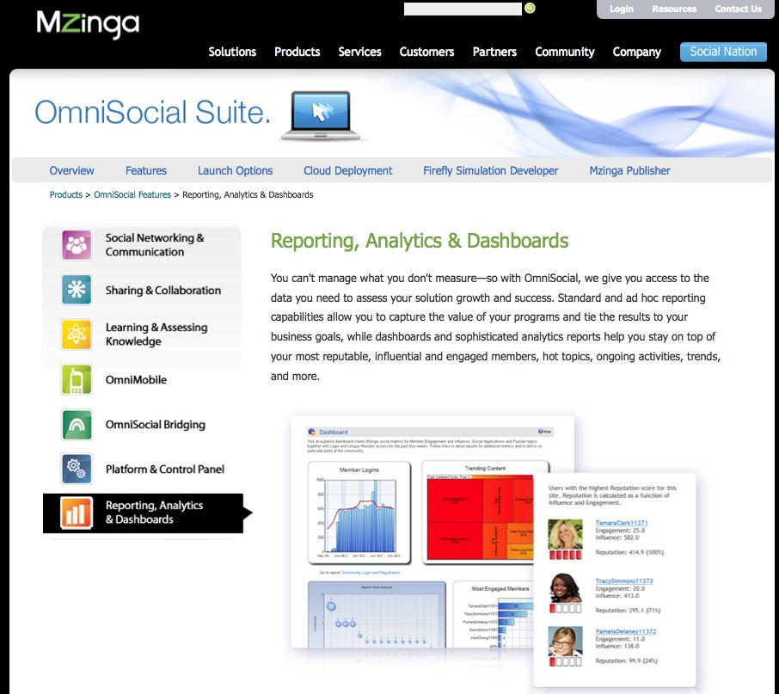
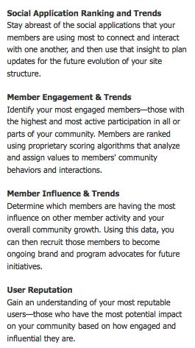
Social analytics start to become a commodity service
http://www.mzinga.com/software/tour.asp

Slide 40
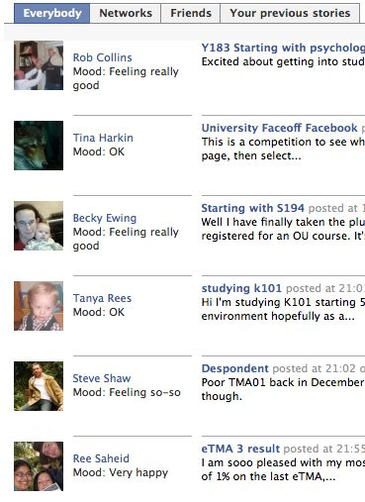
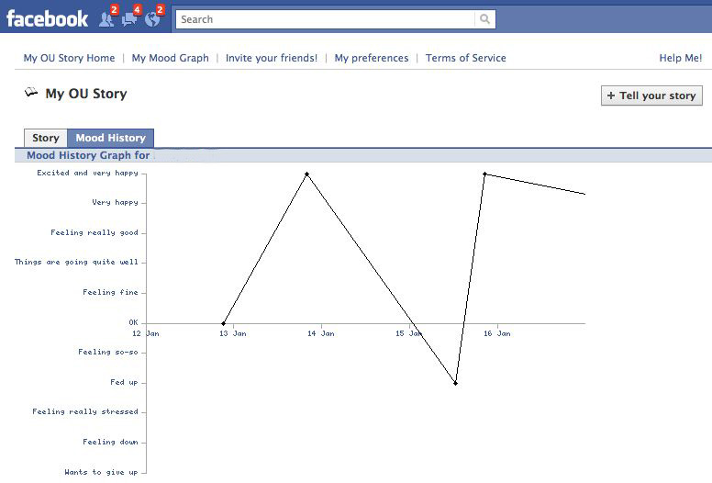
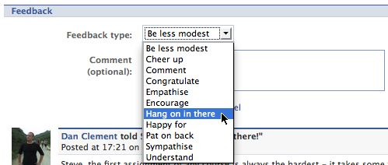
My OU Story app: emotional state
Tony Hirst, Liam Green-Hughes, Stuart Brown
http://apps.facebook.com/myoustory

Slide 41
context
context
context

Slide 42
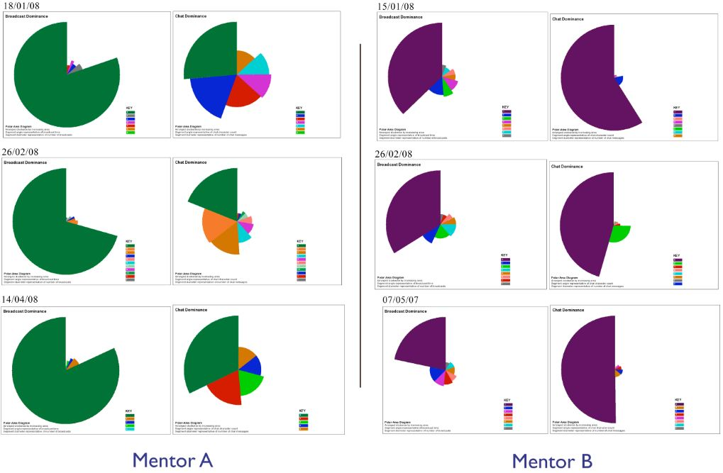
Video conferencing analytics OU KMi’s Flashmeeting
Video conference spoken foreign language tutorials
— which mentor would you want to have?...
Mentor 1
Mentor 2
AV
Chat
AV
Chat
2
Session
3

Slide 43
Video conferencing analytics OU KMi’s Flashmeeting
Video conference spoken foreign language tutorials
— which mentor would you want to have?...
Mentor 1
Mentor 2
AV
Chat
AV
Chat
1
Session
2
3

Slide 44
Video conferencing analytics OU KMi’s Flashmeeting
Video conference spoken foreign language tutorials
— which mentor would you want to have?...
Mentor 1
Mentor 2
AV
Chat
AV
Chat
1
Session
2
3

Slide 45
Video conferencing analytics OU KMi’s Flashmeeting
Video conference spoken foreign language tutorials
— which mentor would you want to have?...
Mentor 1
Mentor 2
AV
Chat
AV
Chat
1
Mentor 1 is doing the best job: at this introductory level, students need intensive input and flounder if left
Session
2
3

Slide 46
Beyond data dashboards: predictive modelling

Slide 47
OU Analytics: Predictive modelling
Probability models help us to identify patterns of success that vary between:
student groups / areas of curriculum / study methods
Benefits
provide a more robust comparison of module pass rates
support the institution in identifying aspects of good performance that can be shared, and aspects where improvement could be realised
Best predictors of future success: previous OU study data – quantity and results
OU Student Statistics & Surveys Team, Institute of Educational Technology

Slide 48
Purdue University Signals Real time traffic-lights in the student VLE, based on a predictive model
http://www.itap.purdue.edu/studio/signals

Slide 49
Purdue University Signals Real time traffic-lights for students based on a predictive model
Premise: academic success is defined as a function of aptitude (as measured by standardized test scores and similar information) and effort (as measured by participation within the CMS).
Using factor analysis and logistic regression, a model was tested to predict student success based on:
ACT or SAT score
Overall grade-point average
CMS usage composite
CMS assessment composite
CMS assignment composite
CMS calendar composite
Campbell et al (2007). Academic Analytics: A New Tool for a New Era, EDUCAUSE Review, vol. 42, no. 4 (July/August 2007): 40–57. http://bit.ly/lmxG2x
Predicted 66%-80% of struggling students who needed help

Slide 50
this all feels rather traditional — isn’t there a learning revolution going on?!

Slide 51
Learning analytics for this?
“We are preparing students for jobs that do not exist yet, that will use technologies that have not been invented yet, in order to solve problems that are not even problems yet.”
“Shift Happens” http://shifthappens.wikispaces.com

Slide 52
Learning analytics for this?
“The test of successful education is not the amount of knowledge that pupils take away from school, but their appetite to know and their capacity to learn.”
Sir Richard Livingstone, 1941

Slide 53
Tectonic shifts in the learning landscape...
TECH: cloud, personalised, real time, multimedia, mobile...
FREE/OPEN: is increasingly expected – I might pay later
SOCIAL LEARNING: innovation now depends on it
VALUES: autonomy, diversity, self-expression, participation
POST-INDUSTRIAL: new institutional roles in post-industrial education
Taken together, these are profound shifts in power, relationships, economics, infrastructure...
As these reshape our conception of the future of learning –they must also reshape our conception of the future of learning analytics

Slide 54
analytics for C21 skills? learning how to learn? authentic enquiry?
social capital critical questioning argumentation citizenship habits of mind resilience collaboration creativity metacognition identity readiness sensemaking engagement motivation emotional intelligence

Slide 55
Analytics for
learning dispositions and transferable skills

Slide 56
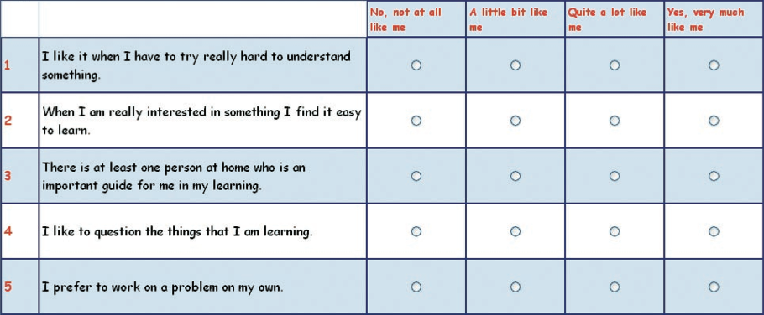
ELLI: Effective Lifelong Learning Inventory Web questionnaire 72 items (children and adult versions: used in schools, universities and workplace)

Slide 57
Validated as loading onto 7 dimensions of “Learning Power”
Being Stuck & Static
Data Accumulation
Passivity
Being Rule Bound
Isolation & Dependence
Being Robotic
Fragility & Dependence
Changing & Learning
Meaning Making
Critical Curiosity
Creativity
Learning Relationships
Strategic Awareness
Resilience
Univ. Bristol and Vital Partnerships provides practitioner resources and tools to support their application in schools and the workplace

Slide 58
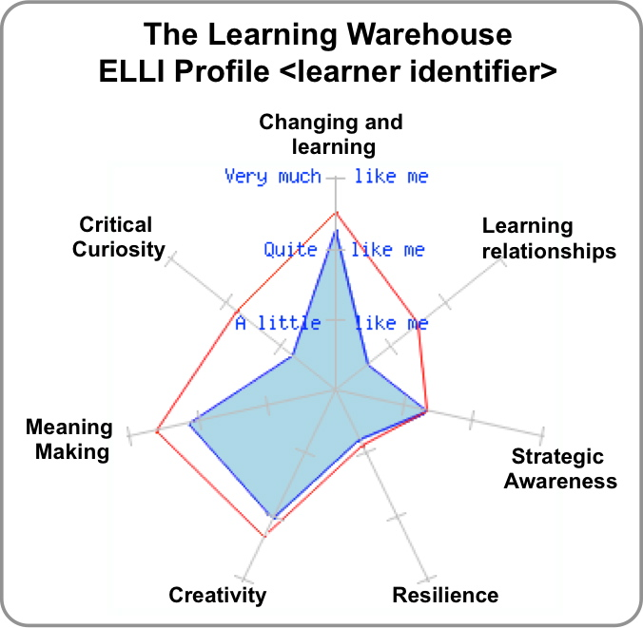
ELLI generates a 7-dimensional spider diagram of how the learner sees themself
Basis for a mentored-discussion on how the learner sees him/herself, and strategies for strengthening the profile
Bristol and Open University are now embedding ELLI in learning software.

Slide 59
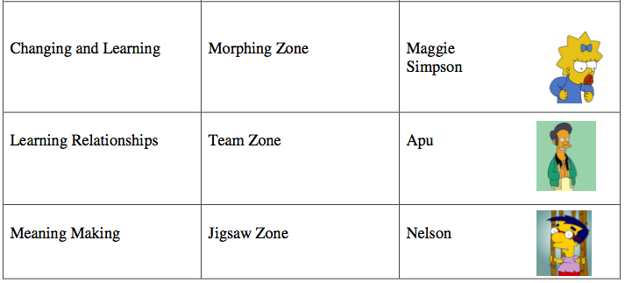
Adding imagery to ELLI dimensions to connect with learner identity

Slide 60
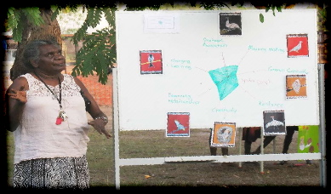
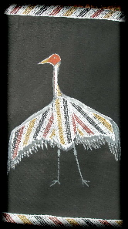
Working with Gappuwiyak School, N. Territory AUS (Ruth Deakin Crick, University of Bristol)
http://bit.ly/srUSHE
Changing & Learning: The Drongo - Guwak
Strategic Awareness: Emu - Wurrpan
Meaning Making: The Pigeon - Nabalawal
Critical Curiosity: Sea Eagle - Djert
Resilience: Brolga - Gudurrku
Learning Relationships: The Cockatoo - Ngerrk
Creativity: Bower Bird - Djurwirr

Slide 61
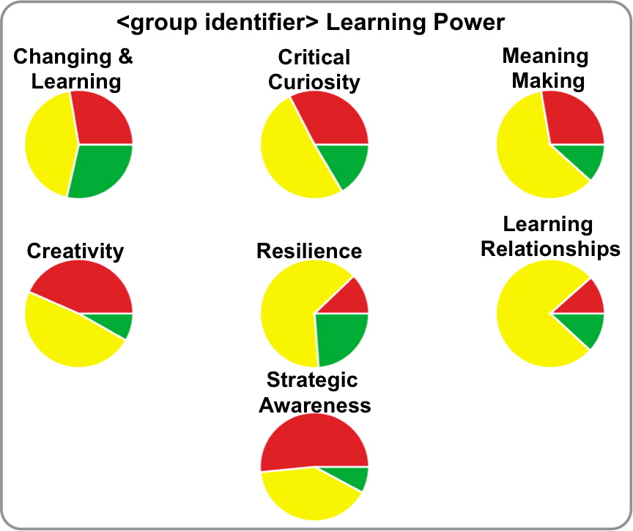
ELLI generates cohort data for each dimension

Slide 62
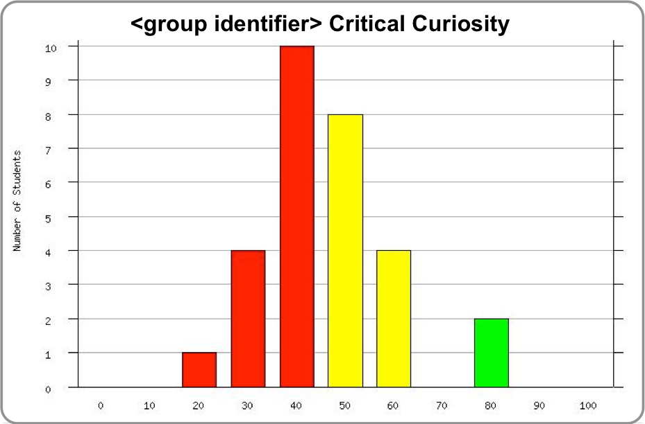
…drilling down on a specific dimension

Slide 63
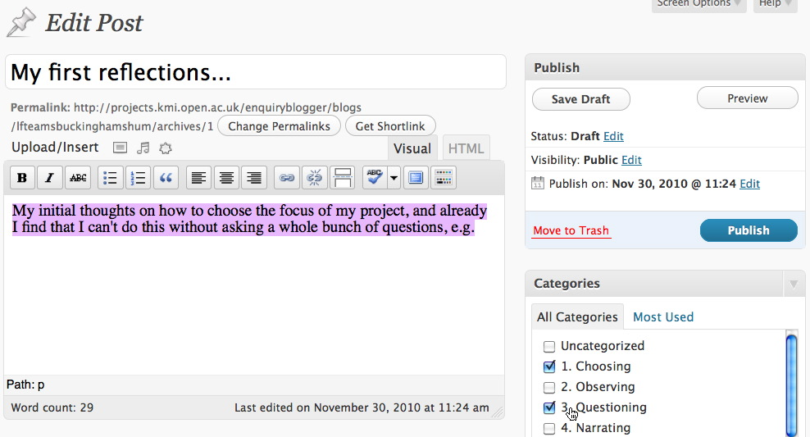
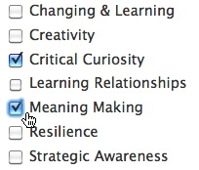
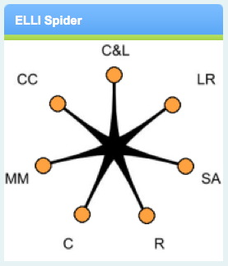
EnquiryBlogger: Tuning Wordpress as an ELLI-based learning journal
Standard Wordpress editor
Categories from ELLI
Plugin visualizes blog categories, mirroring the ELLI spider

Slide 64
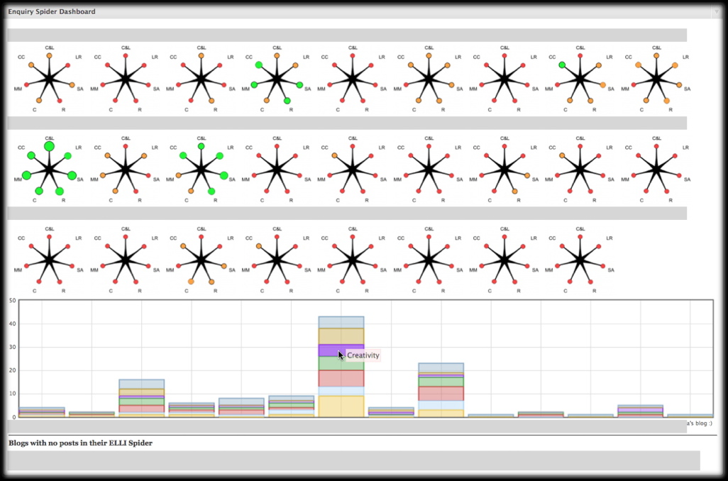
EnquiryBlogger dashboard

Slide 65
LearningEmergence.net
more on analytics for learning to learn and authentic enquiry

Slide 66
Analytics for
learning conversations

Slide 67
Discourse Learning Analytics
Effective learning conversations display some typical characteristics which learners can and should be helped to master
Learners’ written, online conversations can be analysed computationally for patterns signifying weaker and stronger forms of contribution

Slide 68
Socio-cultural discourse analysis (Mercer et al, OU)
Disputational talk, characterised by disagreement and individualised decision making.
Cumulative talk, in which speakers build positively but uncritically on what the others have said.
Exploratory talk, in which partners engage critically but constructively with each other's ideas.
Mercer, N. (2004). Sociocultural discourse analysis: analysing classroom talk as a social mode of thinking. Journal of Applied Linguistics, 1(2), 137-168.

Slide 69
Socio-cultural discourse analysis (Mercer et al, OU)
Exploratory talk, in which partners engage critically but constructively with each other's ideas.
Statements and suggestions are offered for joint consideration.
These may be challenged and counter-challenged, but challenges are justified and alternative hypotheses are offered.
Partners all actively participate and opinions are sought and considered before decisions are jointly made.
Compared with the other two types, in Exploratory talk knowledge is made more publicly accountable and reasoning is more visible in the talk.
Mercer, N. (2004). Sociocultural discourse analysis: analysing classroom talk as a social mode of thinking. Journal of Applied Linguistics, 1(2), 137-168.

Slide 70
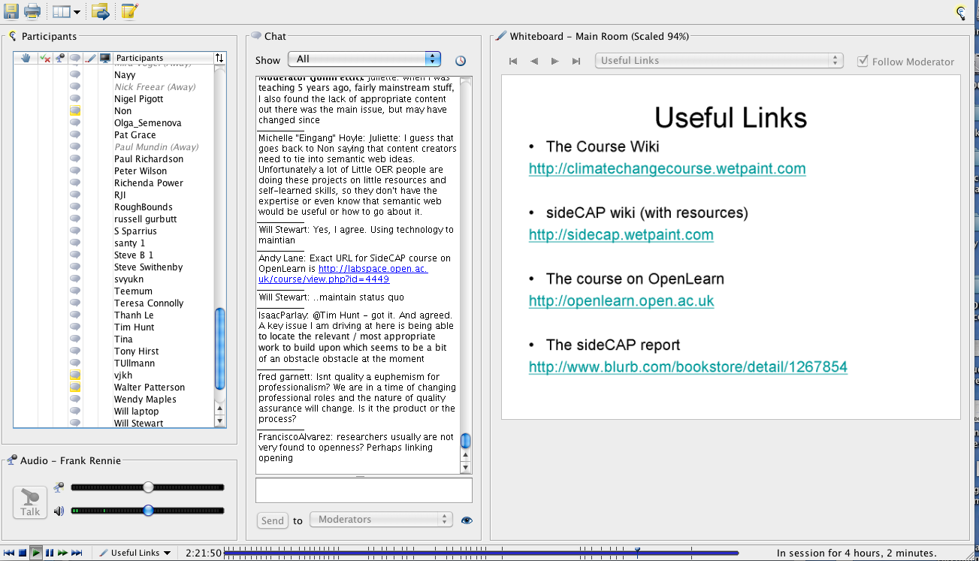
Analytics for identifying Exploratory talk
Elluminate sessions can be very long – lasting for hours or even covering days of a conference
It would be useful if we could identify where quality learning conversations seem to be taking place, so we can recommend those sessions, and not have to sit through online chat about virtual biscuits
Ferguson, R. and Buckingham Shum, S. Learning analytics to identify exploratory dialogue within synchronous text chat. 1st International Conference on Learning Analytics & Knowledge (Banff, Canada, 27 Mar-1 Apr, 2011)

Slide 71
Defining indicators of Exploratory Talk
Category | Indicator
Challenge | But if, have to respond, my view
Critique | However, I’m not sure, maybe
Discussion of resources | Have you read, more links
Evaluation | Good example, good point
Explanation | Means that, our goals
Explicit reasoning | Next step, relates to, that’s why
Justification | I mean, we learned, we observed
Reflections of perspectives of others | Agree, here is another, makes the point, take your point, your view

Slide 72
Extract classified as Exploratory Talk
Time | Contribution
2:42 PM | I hate talking. :-P My question was whether "gadgets" were just basically widgets and we could embed them in various web sites, like Netvibes, Google Desktop, etc.
2:42 PM | Thanks, that's great! I am sure I understood everything, but looks inspiring!
2:43 PM | Yes why OU tools not generic tools?
2:43 PM | Issues of interoperability
2:43 PM | The "new" SocialLearn site looks a lot like a corkboard where you can add various widgets, similar to those existing web start pages.
2:43 PM | What if we end up with as many apps/gadgets as we have social networks and then we need a recommender for the apps!
2:43 PM | My question was on the definition of the crowd in the wisdom of crowds we acsess in the service model?
2:43 PM | there are various different flavours of widget e.g. Google gadgets, W3C widgets etc. SocialLearn has gone for Google gadgets

Slide 73
Discourse analysis (Xerox Incremental Parser)
Detection of salient sentences based on rhetorical markers:
BACKGROUND KNOWLEDGE:
Recent studies indicate …
… the previously proposed …
… is universally accepted ...
NOVELTY:
... new insights provide direct evidence ...
... we suggest a new ... approach ...
... results define a novel role ...
OPEN QUESTION:
… little is known …
… role … has been elusive
Current data is insufficient …
CONRASTING IDEAS:
… unorthodox view resolves … paradoxes …
In contrast with previous hypotheses ...
... inconsistent with past findings ...
SIGNIFICANCE:
studies ... have provided important advances
Knowledge ... is crucial for ... understanding
valuable information ... from studies
SUMMARIZING:
The goal of this study ...
Here, we show ...
Altogether, our results ... indicate
GENERALIZING:
... emerging as a promising approach
Our understanding ... has grown exponentially ...
... growing recognition of the
importance ...
SURPRISE:
We have recently observed ... surprisingly
We have identified ... unusual
The recent discovery ... suggests intriguing roles
Ágnes Sándor & OLnet Project: http://olnet.org/node/512
De Liddo, A., Sándor, Á. and Buckingham Shum, S. (In Press). Contested Collective Intelligence: Rationale, Technologies, and a Human-Machine Annotation Study. Computer Supported Cooperative Work Journal

Slide 74
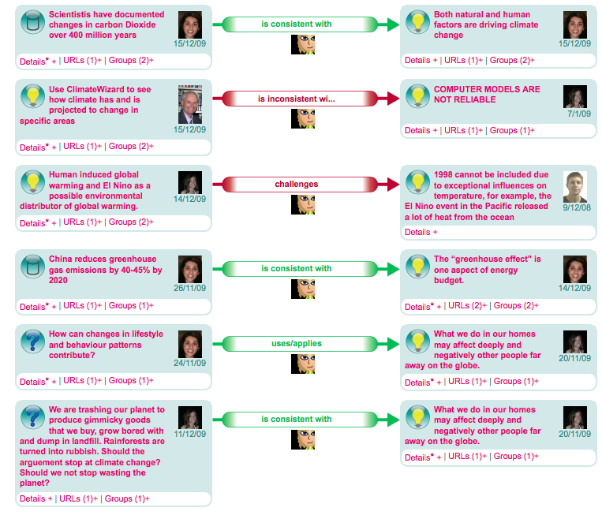
KMi’s Cohere: a web deliberation platform enabling semantic social network and discourse network analytics
Rebecca is playing the role of broker, connecting 2 peers’ contributions in meaningful ways
De Liddo, A., Buckingham Shum, S., Quinto, I., Bachler, M. and Cannavacciuolo, L. Discourse-centric learning analytics. 1st International Conference on Learning Analytics & Knowledge (Banff, 27 Mar-1 Apr, 2011)
Notes:
Another analytic afforded by semantic discourse of this sort concerns the degree to which users’ act as information brokers between others. Since connecting is an explicit, reflective act in Cohere, it is straightforward to count how many times learners create semantic connections between nodes authored by others (Figure 9).

Slide 75
Learning Analytics stories from the near future

Slide 76
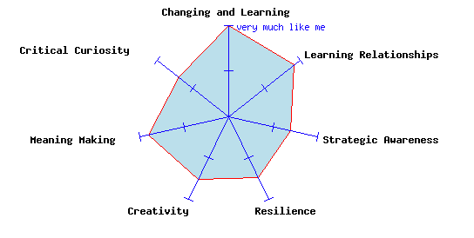
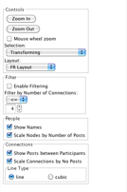
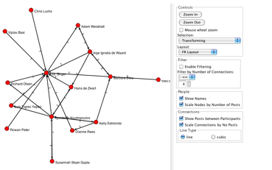
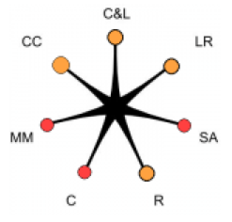
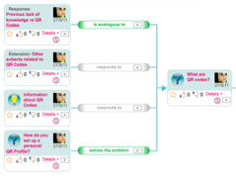
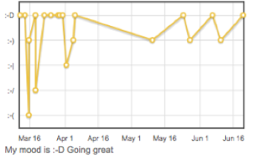
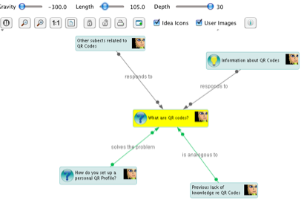
Dream? Student’s analytics dashboard
1
2
3
In your last discussion with your mentor, you decided to work on your resilience by taking on more learning challenges
5
Your ELLI Spider shows that you have made a start on working on your resilience, and that you are also beginning to work on your creativity, which you identified as another area to work on.
4
Your most recent mood comment: “Great, at last I have found all the resources that I have been looking for, thanks to
Steve and Ellen.
Based on: Buckingham Shum, S. and Ferguson, R. (2011). Social Learning Analytics. Available as: Technical Report KMI-11-01, Knowledge Media Institute, The Open University, UK. http://kmi.open.ac.uk/publications/pdf/kmi-11-01.pdf

Slide 77
Mr A. Administrator (2015)
Course Application: Analytics Report
Application from Ali Bloggs to study Z0001
This applicant has a high risk profile:
No academic study for last 15 years
Low socio-economic background
English as a second language
Weak ICT skills
His responses to the learning styles survey indicate a loner, rather than a collaborative learner, known to be a disadvantage on this course
Without a Grade 3 tutor (advanced skills in 1-1 support), based on the last 5 years data there is a 37% chance of dropping out by Week 6. Recruiting this tutor will take you over budget.
Recommended decision: REJECT
[ACCEPT] [REJECT]

Slide 78
Ms. S. Student (2015)
“Hi Sue,
In the last 2 weeks, it looks like you’ve been really stretching yourself. You seem to have been working on your critical thinking, with that challenge to Mike’s assumption, and the evidence-based claim about nuclear waste in your blog.
Check out Donna Winter, who seems to have very different views to yours on global warming. How would you assess her position?
In your next video conference tutorial, try to improve on the last three when you seem to have contributed only once each time.”

Slide 79
Ms. S. Student (2015)
“Did you know that two other people you know have used the Smith & Jones 2009 framework graphic?
Finally, you seem to have really become a pivotal member of the Local-Global Climate Network. Good work: only a month ago you were on the edge!
Why not reflect in your blog on how these groups are helping you in your long term goal to Work for the UN in Africa?”

Slide 80
Prof. R. Researcher (2015)
Learner 2020 Project:
Analytics report to Rachel Richards:
3761 students are working from 27 resources, 4 of them provided by the course.
Presentation of SNA viz. to Experimental Grp.1 resulted in 79% of outlying community members taking at least 1 of the recommended actions and moving themselves to more strategic positions in the network: 35% towards the centre, 17% to broker with another relevant network, and 27% with a low-relevance network.
Currently, this represents a statistically significant effect according to Hypothesis 1 (p<0.05)

Slide 81
Dr L. Lecturer (2015)
Z0001: Week 4 Analytics Report
Dear Les,
Please find below key headlines [full report]:
29 students have engaged in at least one empathic conversation with a peer. This is below the 5 year mean for 2012-17, but 10% better than last year. Your arrival on the course has made an impact!
13 students display low resilience when stretched, at levels predictive of failure to complete. Please review the mentoring recordings to verify that appropriate interventions are in place.
Biometric data indicate abnormally high levels of distress in 3 students whenever team working is mentioned.

Slide 82
Closing thoughts

Slide 83
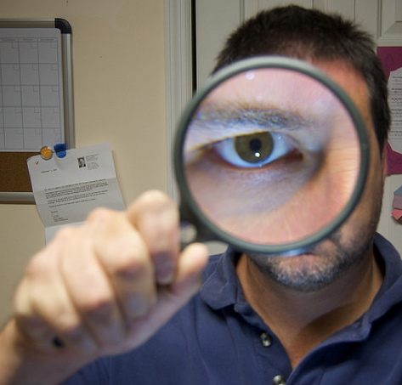
http://www.flickr.com/photos/somegeekintn/3709203268/
Who gets to define, and hold, the magnifying glass?

Slide 84
http://www.flickr.com/photos/centralasian/6396004353/sizes/m/in/photostream/
Learning Analytics should provide mirrors for learners to become more reflective, and less dependent

Slide 85
As Big Data and Analytics mature we will see the convergence of…
institutional data sources

Slide 86
As Big Data and Analytics mature we will see the convergence of…
+ voluntarily shared learner data

Slide 87
As Big Data and Analytics mature we will see the convergence of…
+ scavenging in the wild clouds for relevant signals

Slide 88
Power
Learning Analytics
Principles
Pedagogy

Slide 89
dream
timely interventions
empowered, reflective learners
a living evidence-base
open interoperable LA
Nightmare
learners disempowered
regressive pedagogy
HEI “vs” learner interests
Fairydust
over-optimistic, decontextualised claims about predictive power

Slide 90
SoLAResearch.org
Sign up for news
twitter @solaresearch

Slide 91
International Conference on Learning Analytics & Knowledge 2012
Vancouver, 29 April – 2 May 2012
http://lak12.sites.olt.ubc.ca

Slide 92
Simon Buckingham Shum
Knowledge Media Institute, The Open University UK
Slides now up: simon.buckinghamshum.net @sbskmi
This keynote is dedicated to my Father
Jonathan Chung-Hin Shum
4 Jan. 1930 – 27 Nov. 2011

